Slide 1
Tutorial
List your activities
Categorize them in
Activity of the Self (I)
Activity of the Self (I) and Body
Activity of the Body

Slide 2
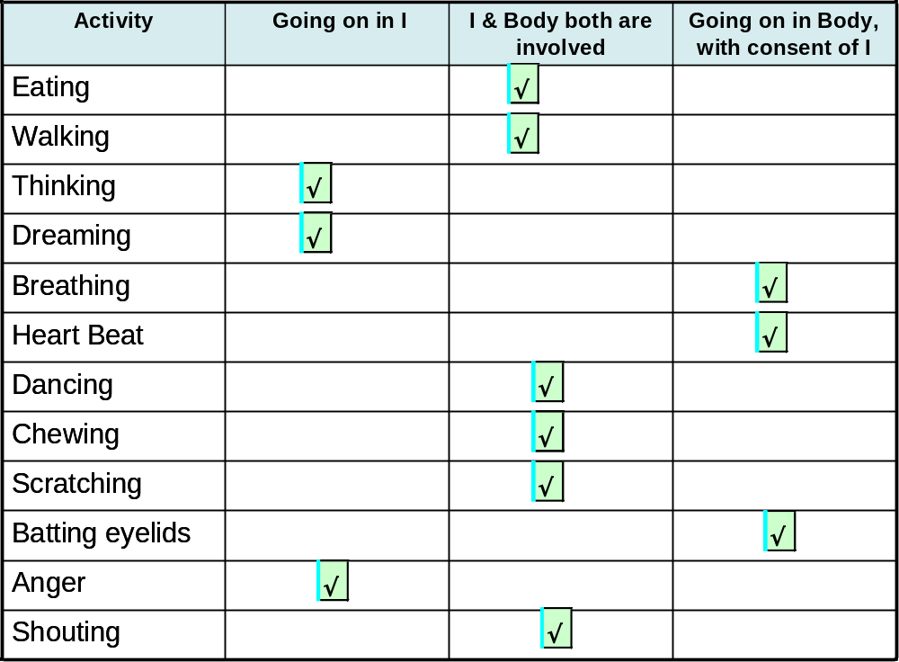

Slide 3
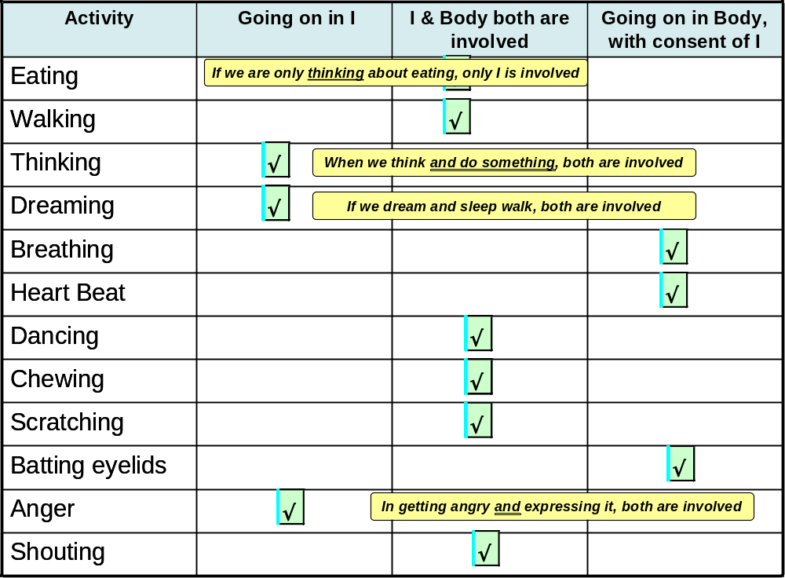

Slide 4
Brain – Communication between Body and Self (I)
Collects the state of the Body every moment. This information is available for the Self (I)
It is the decision of the Self (I) to access this information or not to access this information. The Self (I) accesses that part of the information which it considers revelant/important
Acts on the instructions received from the Self (I). It generated the micro instructions required to act on the instruction from the Self (I) and transmits them to the different parts of the Body
The Body executes the micro instructions. The Body is able to execute these micro instructions only if it is in good health
Local or general anesthesia: the part of the body is not able to send information to the brain, or the whole body is not able to send sensation to the brain… so the brain is not able to make the information available for the Self(I) to access
Brain dead situation: the brain is malfunctioning. The information about the body is not able to reach the brain and thus the brain can not make it available to the Self(I)

